Slide 1



Evolutionary Computation Meets Machine Learning for Combinatorial Optimisation
Yi Mei¹ and Günther Raidl²
1 Victoria University of Wellington, New Zealand
2 TU Wien, Vienna, Austria
yi.mei@ecs.vuw.ac.nz
raidl@ac.tuwien.ac.at
http://gecco-2024.sigevo.org/
Permission to make digital or hard copies of part or all of this work for personal or classroom use is granted without fee provided that copies are not made or distributed for profit or commercial advantage and that copies bear this notice and the full citation on the first page. Copyrights for third-party components of this work must be honored. For all other uses, contact the owner/author(s).
GECCO '24 Companion, July 14 - 18, 2024, Melbourne, Australia
© 2024 Copyright held by the owner/author(s).
ACM ISBN 979-8-4007-0495-6/24/07. . . $15.00
https://doi.org/10.1145/3638530.3648413.

Slide 2



Instructors
Yi Mei is an Associate Professor at the Centre for Data Science and Artificial Intelligence and School of Engineering and Computer Science, Victoria University of Wellington, New Zealand. His research interests include evolutionary computation and machine learning for combinatorial optimisation. He is the Chair of the IEEE Taskforce on Evolutionary Scheduling and Combinatorial Optimisation. He is a Fellow of Engineering New Zealand.
Günther Raidl is at the Institute of Logic and Computation, TU Wien, Austria, and member of the Algorithms and Complexity Group. He received his PhD in 1994 and completed his habilitation in Practical Computer Science in 2003 at TU Wien. In 2005 he received a professorship position for combinatorial optimization at TU Wien.

Slide 3
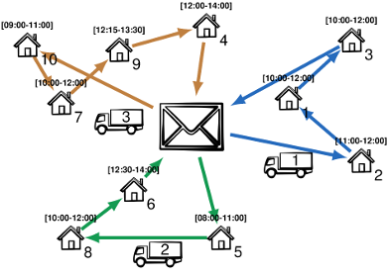
Combinatorial Optimisation
Many Real-world applications
Supply chain/logistics
Cloud computing
Manufacturing
Machine learning
…
NP-hard, local optima

Slide 4
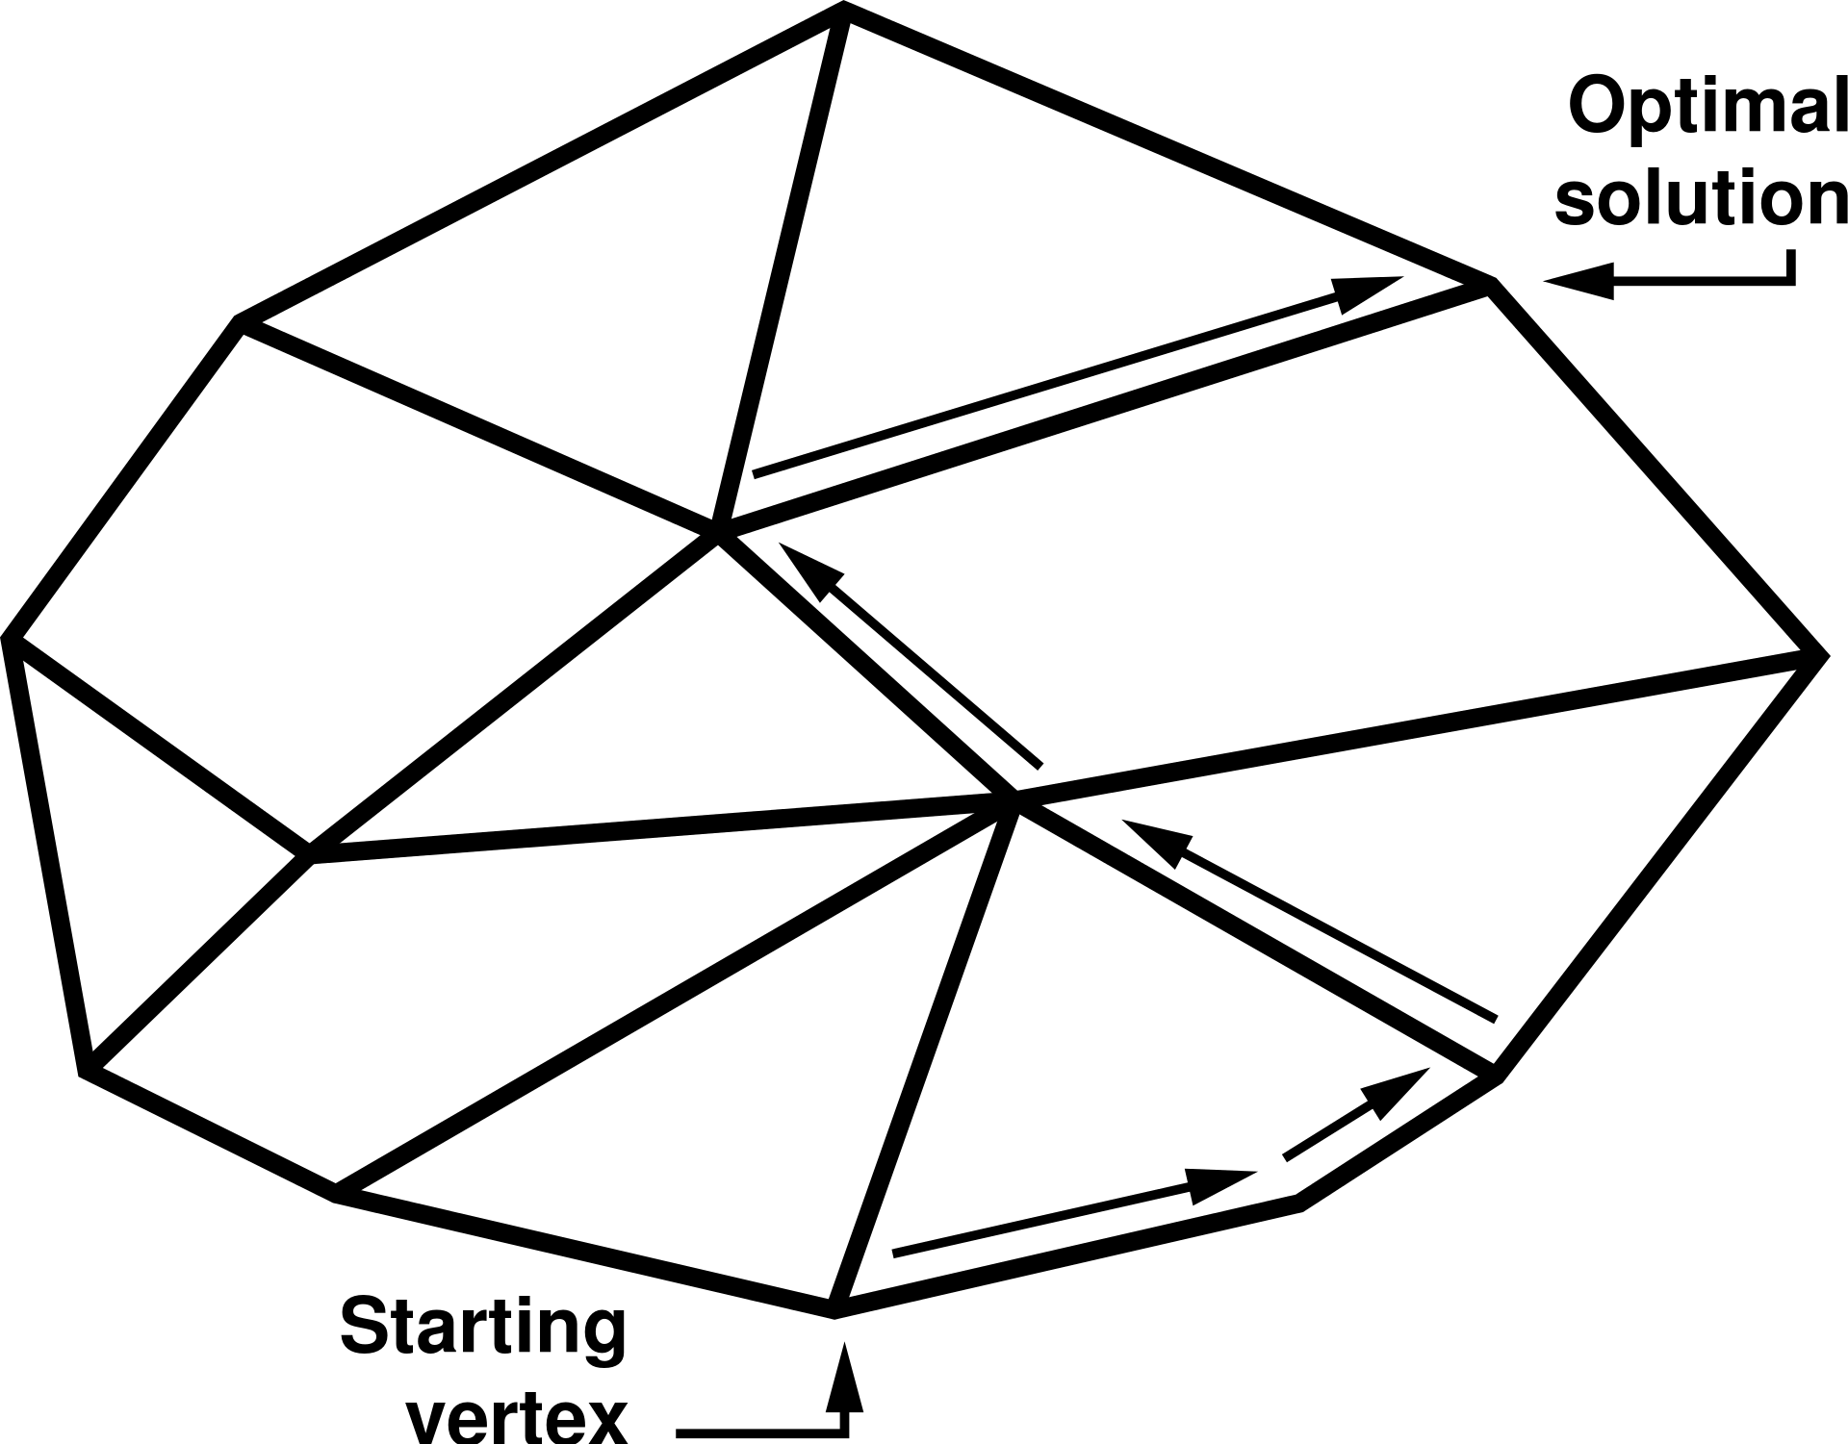
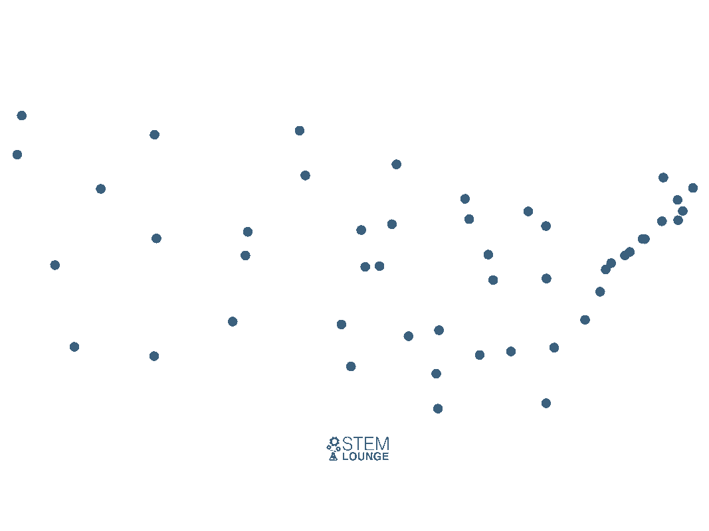
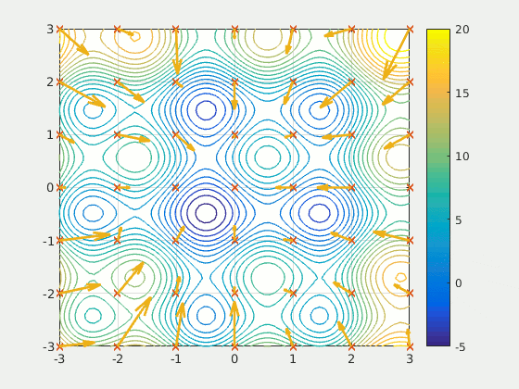
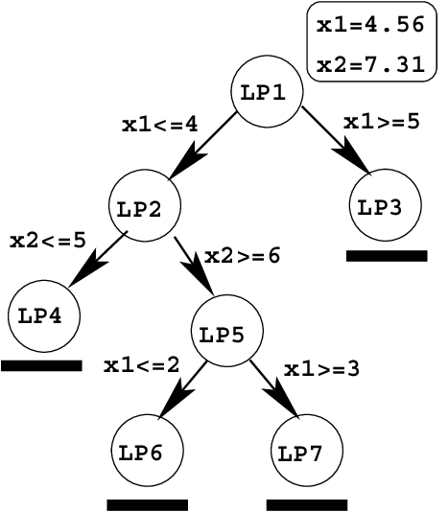
Combinatorial Optimisation Methods
Exact Methods
Constructive heuristics
Meta-heuristics
Simplex
Branch and Bound
Nearest neighbour for TSP
PSO

Slide 5
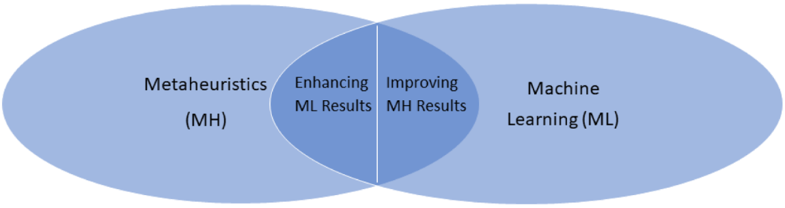
Evolutionary Computation, Metaheuristics, and Learning
AI/machine learning (ML) boom also hit the area of combinatorial optimization (COP)
Evolutionary Computation and other (meta-)heuristics relate to machine learning in many different ways

Slide 6
Outline
Introduction and Background
Evolutionary Computation to Learn Combinatorial Optimisation Heuristics
Machine Learning to Aid (Meta-)heuristics
Challenges and Future Directions

Slide 7
Introduction and Background

Slide 8
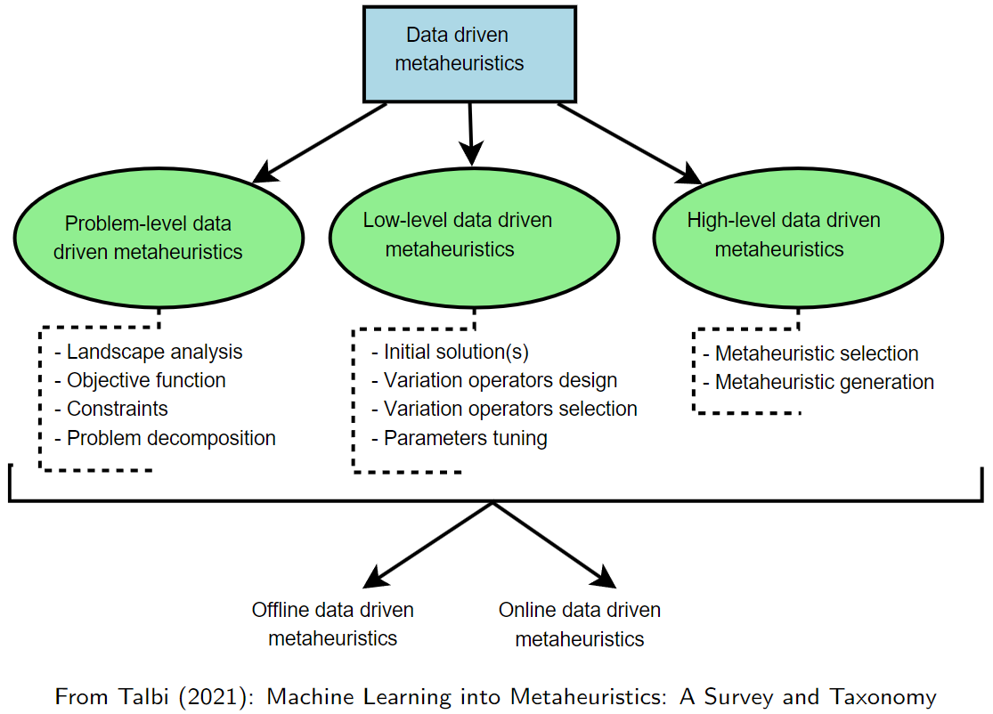
Learning to (Better) Optimize

Slide 9
Survey Articles
M. Karimi-Mamaghan, M. Mohammadi, P. Meyer, A. M. Karimi-Mamaghan, E.-G. Talbi (2021): Machine Learning at the Service of Metaheuristics for solving COPs: A State-of-the Art, EJOR
E. G.Talbi (2021): Machine Learning into Metaheuristics: A Survey and Taxonomy, ACM Computing Surveys
N. Mazyavkina, S. Sviridov, S. Ivanov, E. Burnaev (2021): Reinforcement Learning for Combinatorial Optimization: A Survey; COR
C. Zang, Y. Wu, Y. Ma, W. Song, Z. Le (2023): A Review on Learning to Solve Combinatorial Optimization Problems in Manufacturing, IET Collaborative Intelligent Manufacturing

Slide 10
Some Classical Metaheuristics Involving Learning
Basic idea of learning in (meta-)heuristics not new:
Evolution Strategies
Reactive tabu search
Guided Local Search
Variable Neighborhood Search, Adaptive Large Neighborhood Search
self-adaptive selection of neighborhood structures/operators
Hyper-heuristics
Ant Colony Optimization

Slide 11
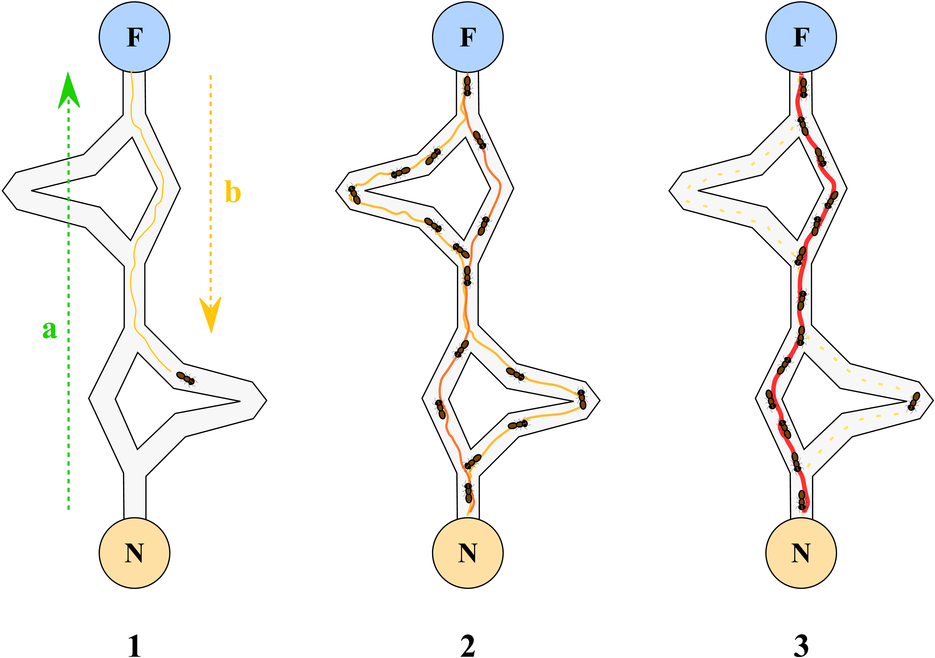
Idea of Ant Colony Optimization
Iteratively construct solutions in a randomized greedy fashion
Additionally consider pheromone values:
Decisions in good solutions are reinforced by increasing their pheromone values while other values are reduced by “evaporation”
from https://de.wikipedia.org/wiki/Ameisenalgorithmus

Slide 12
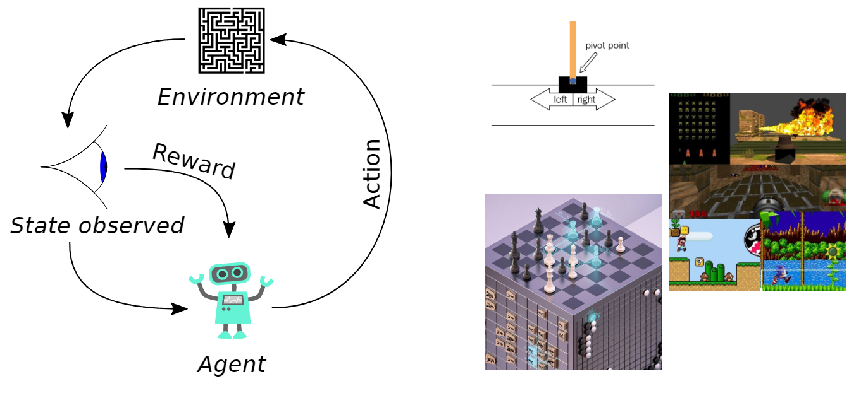
Reinforcement Learning
A sub-discipline of machine learning
Learn to behave well in a given environment
usually considered a Markov Decision Process (MDP)
Framework:

Slide 13
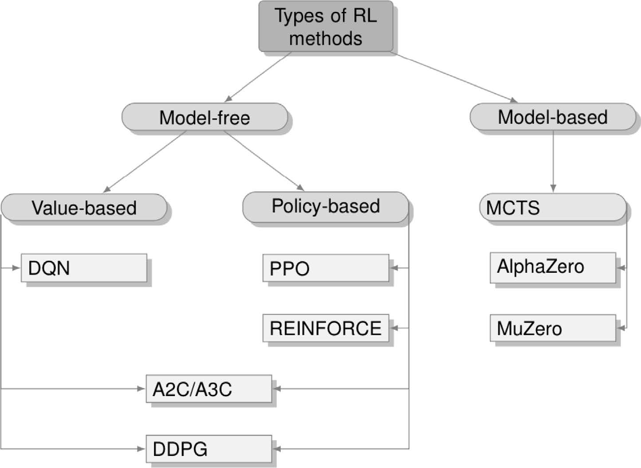
Reinforcement Learning (RL) - Classification
from Mazyavkina et al. ( 2021): Reinforcement learning for combinatorial optimization: A survey, C&OR 134(105400)

Slide 14
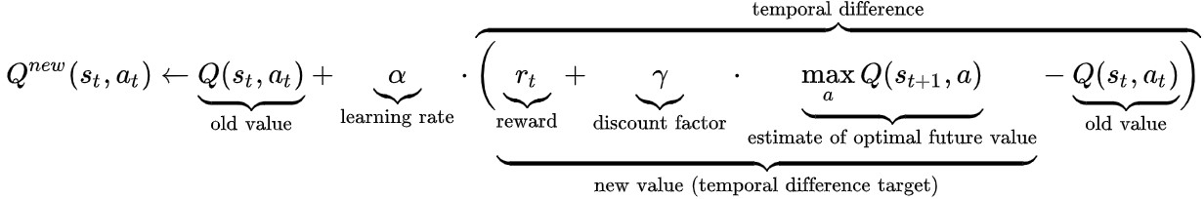
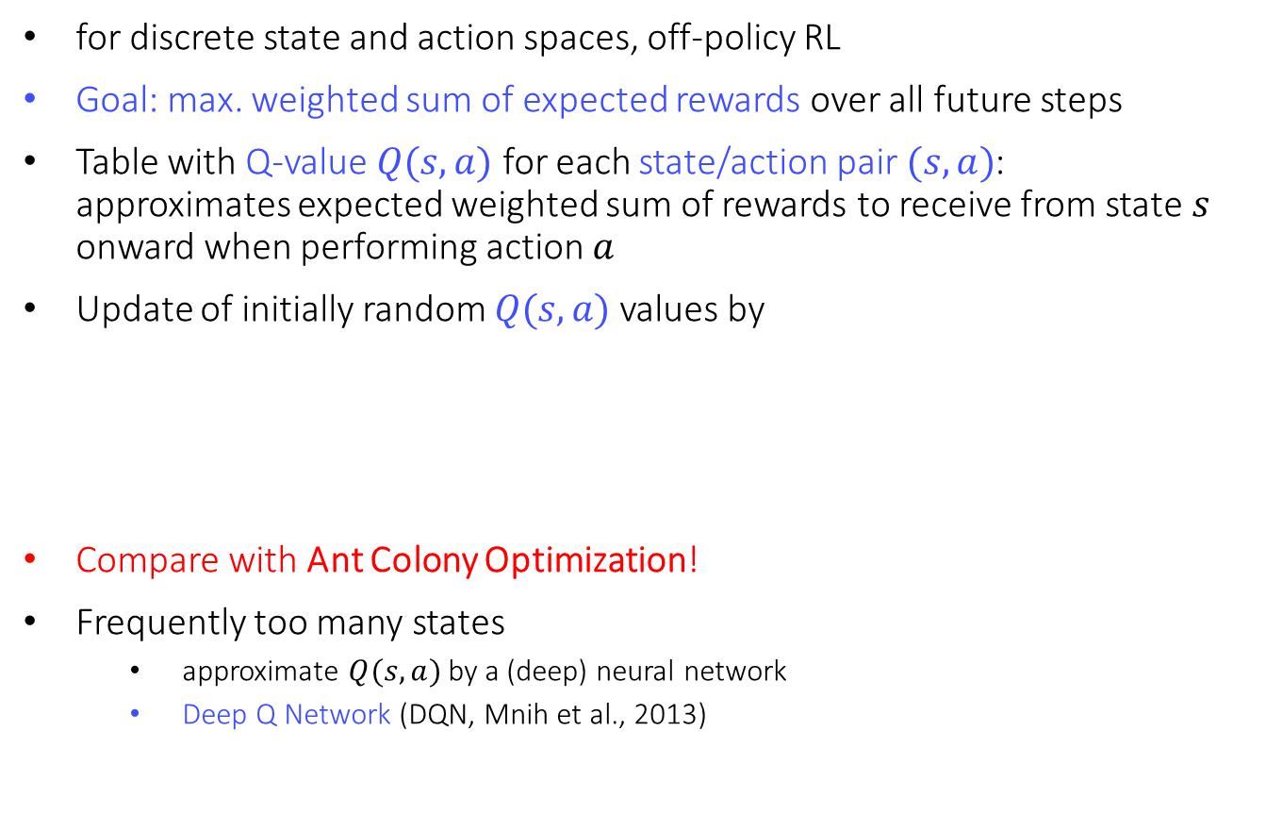
Q-Learning (Watkins and Dayan, 1992)
for discrete state and action spaces, off-policy RL
Goal: max. weighted sum of expected rewards over all future steps
Table with Q-value $Q(s,a)$ for each state/action pair $(s, a)$: approximates expected weighted sum of rewards to receive from state $s$ onward when performing action $a$
Update of initially random $Q(s, a)$values by
Compare with Ant Colony Optimization!
Frequently too many states
approximate $Q(s, a)$by a (deep) neural network
Deep Q Network (DQN, Mnih et al., 2013)

Slide 15
Machine Learning for CO
Learning to construct (initial) solutions
Learning to search in the solution space
Supervised learning
Collect data on problem instances + optimal solutions/steps
Learn to mimic the optimal solutions/steps
Reinforcement learning
Given training problem instances, no solution needed
Learn a policy to make decisions
Reward/Quality indicators
How good the policy is
Based on solutions obtained by the policy

Slide 16
Learning to Construct
End-to-end learning
Input: problem instance
Output: a solution
Usually outputs the final solution, but may also be used as initial solution followed by a search process
Key design issues:
Encoding of the problem instance (input)
Encoding of the solution (output)
Model architecture
Learning method

Slide 17
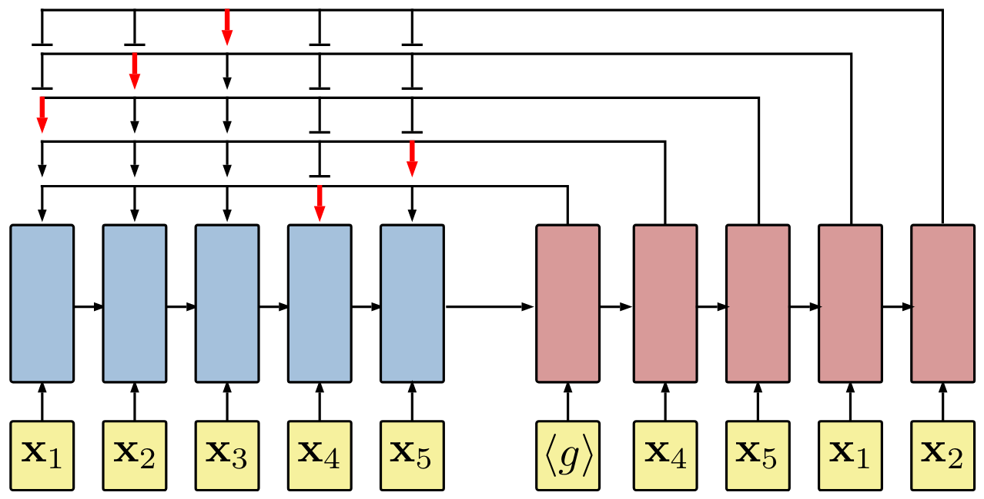
Example: RNN for TSP
Problem: Find the shortest cycle to visit all the nodes in a graph
Design:
Input: nodes as a sequence
Output: solution as a sequence
Model: recurrent neural network
Cannot generalise to more nodes
Bello, I., Pham, H., Le, Q. V., Norouzi, M., & Bengio, S. (2016). Neural combinatorial optimization with reinforcement learning. arXiv preprint arXiv:1611.09940.

Slide 18
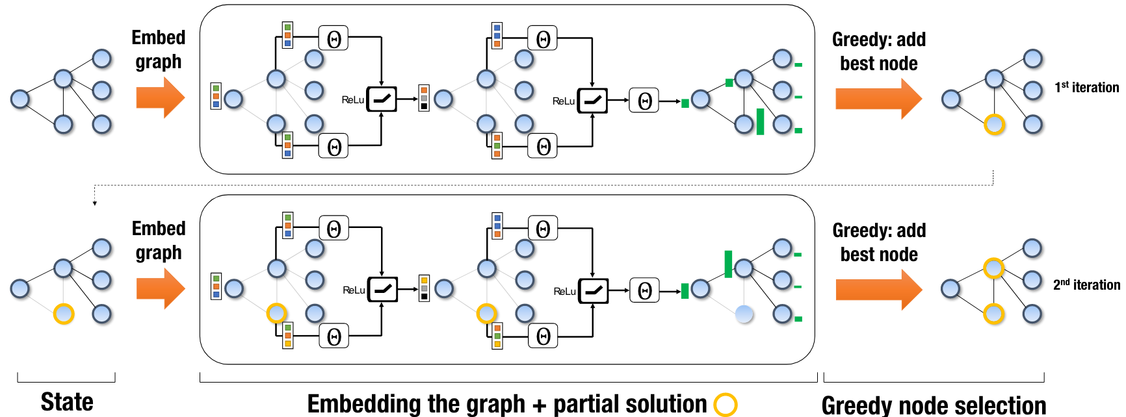
Example: Learn to Solve Minimum Vertex Cover
Problem: Find the minimal subset of vertices to cover all the vertices in a graph
Design:
Input: graph embedding (graph neural network)
Output: 0/1 for each vertex
Model: graph neural network
Reinforcement learning: learn a policy to add nodes
Can generalize to different graphs
Khalil, E., Dai, H., Zhang, Y., Dilkina, B., & Song, L. (2017). Learning combinatorial optimization algorithms over graphs. Advances in Neural Information Processing Systems, 30.

Slide 19
Learn to Search
Machine learning to make design decisions of search algorithms
Select the next branch during branch and bound
Select the next neighbouring solution during local search
Select the next crossover/mutation operator in an EC algorithm

Slide 20
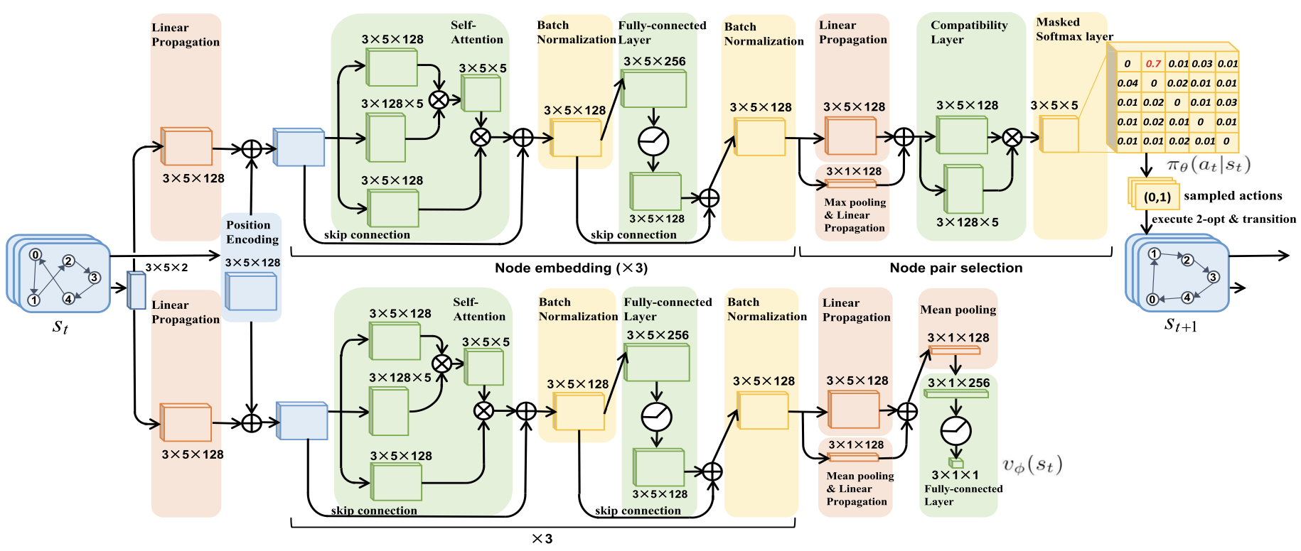
Example: Learn 2-opt for Routing
Iterative improvement process
Solution -> 2-opt -> Solution -> 2-opt -> …
Learn a policy to select a pair of nodes to conduct 2-opt
Reinforcement learning process
Wu, Y., Song, W., Cao, Z., Zhang, J., & Lim, A. (2021). Learning improvement heuristics for solving routing problems. IEEE Transactions on Neural Networks and Learning Systems, 33(9), 5057-5069.

Slide 21
Evolutionary Computation to Learning Combinatorial Optimisation Heuristics

Slide 22
EC to Learn CO Heuristics
Instance
Framework
Component
Component
Define a space of heuristics
A framework for the heuristic to work within
Input: a CO problem instance
Output: a solution
Representation/Encoding for heuristics
Define the evaluation of heuristics
Training data
Performance metric (e.g., effectiveness, efficiency, complexity)
Black-box, non-differentiable, discrete
Design search algorithms by EC
Good at black-box optimisation
Handle non-differential space
Multi-objective optimisation
Heuristic
Component
Parameter
Parameter
Solution

Slide 23
EC to Learn CO Heuristics
Preprocessing
Design a framework $Γ$ parameterized with the CO heuristic
Design a framework Γ parameterized with the CO heuristic
Encoding
Decide the space $ℋ$ of all possible CO heuristics in consideration
Decide the space ℋ of all possible CO heuristics in consideration
Data:
Determine a training set $Ρ$ (problem instances) to train the heuristics
Determine a training set Ρ (problem instances) to train the heuristics
Objective:
Design the training objective function $f(h,Ρ,Γ)$
Design the training objective function 𝑓(ℎ,Ρ,Γ)
Optimisation:
Find the best heuristic $h^{∗}=\arg{\min_{h∈ℋ}{f(h,Ρ,Γ)}}$
Find the best heuristic ℎ^∗=arg⁡min┬(ℎ∈ℋ)⁡〖𝑓(ℎ,Ρ,Γ)〗

Slide 24
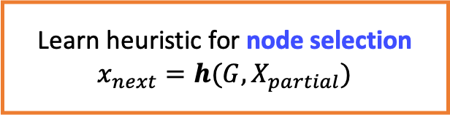
Example 1: TSP
Initialise an empty tour
All nodes visited
yes
Return the constructed tour
no
Select an unvisited node to visit next
Framework:
append nodes one-by-one
Learn heuristic for node selection
$$x_{next}=h(G, X_{partial})$$
Khalil, E., Dai, H., Zhang, Y., Dilkina, B., & Song, L. (2017). Learning combinatorial optimization algorithms over graphs. Advances in neural information processing systems, 30.

Slide 25
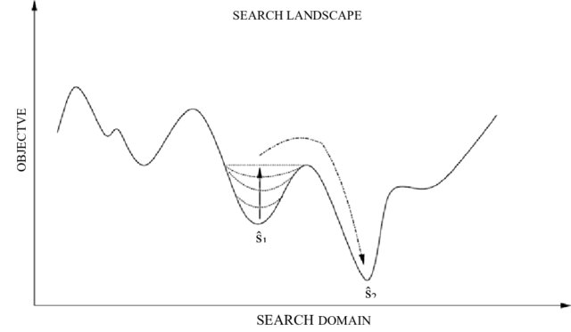
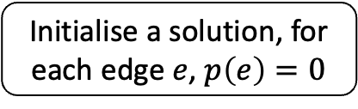
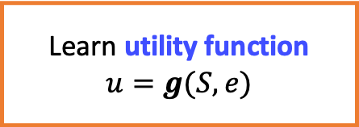
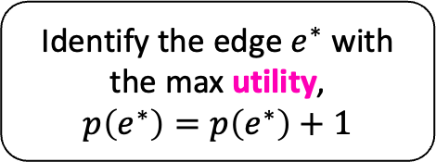
Example 2: GLS for VRP
Initialise a solution, for each edge $e$, $p\left(e\right)=0$
Stop?
yes
Return the best solution
no
Local search to reach a local optimum in terms of the augmented function
Learn utility function
$$u=g(S, e)$$
Identify the edge $e^{∗}$ with the max utility,
$$p\left(e^{∗}\right)=p\left(e^{∗}\right)+1$$

Slide 26
Genetic Programming for Heuristic Learning
Preprocessing
Through prior knowledge and intuition
Encoding
Trees
Data
A wide range of problem instances
Generalisation and efficiency (problem size, #instances) are important
Objective function
Normalised objective values of the obtained solutions
Optimisation
Genetic programming
A simulation to output a solution
Sequence of instructions

Slide 27
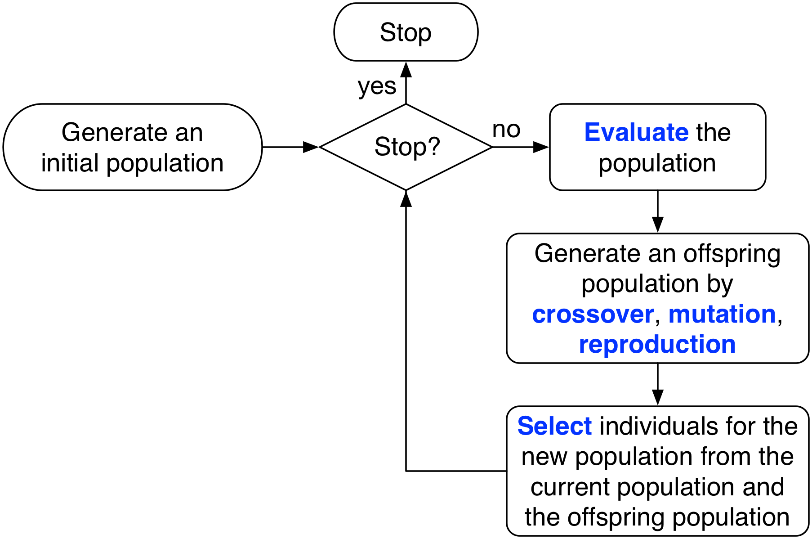
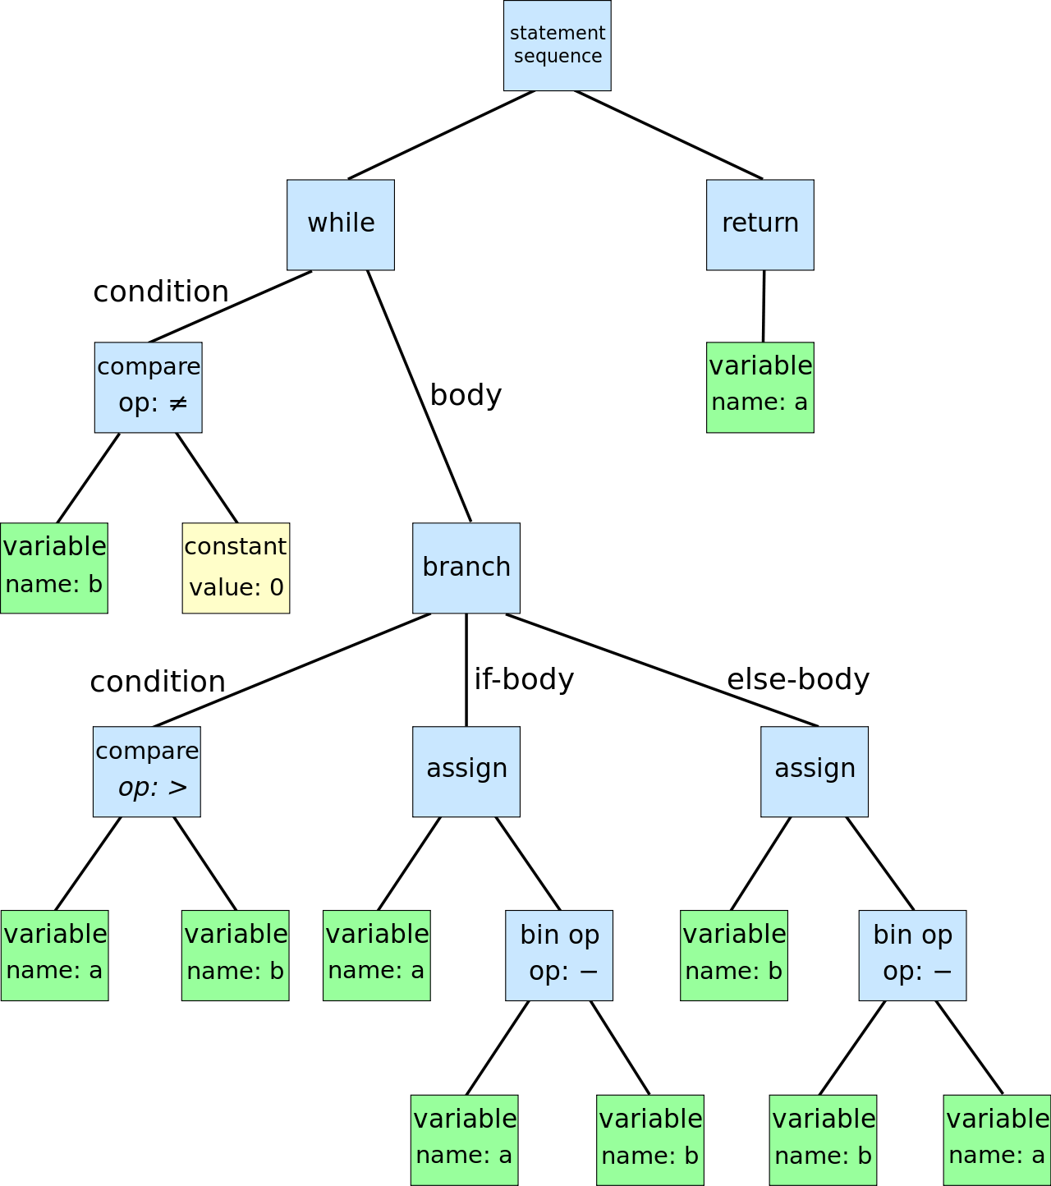
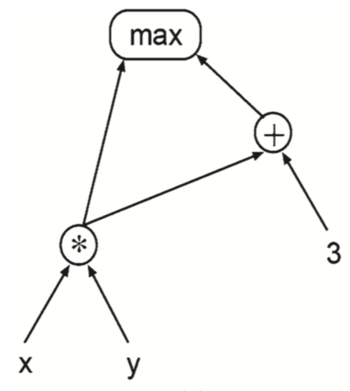

Genetic Programming (GP)
A type of evolutionary algorithm
Evolve computer programs rather than solutions
Representation of computer programs
Tree-like, graph-like, linear, …
while b ≠ 0 if a > b a := a − b else b := b − a return a
r[3] = r[1] / 1.3;
r[1] = r[2] * -5.5;
r[0] = if r[1] < 0 then
r[0] else r[3];
$$\max\left(x∗y,x∗y+3\right)$$

Slide 28

Genetic Programming (GP)
Individual generation (Tree-based representation)
Terminal set: inputs of the program and constants, no argument, form the leaf nodes,
Function set: operators to the inputs and intermediate results of the program (e.g., +, -, max, …), form the non-leaf nodes
Start from the root node
For each node, randomly sample from the terminal/function set
If sampling from the terminal set, then stop this branch
If sampling from the function set, create the child nodes, and recursively sample the child nodes
+
Terminals | Functions
x | +
y | -
1 | *
 | /
*
y
x
1
$$x∗1+y$$

Slide 29
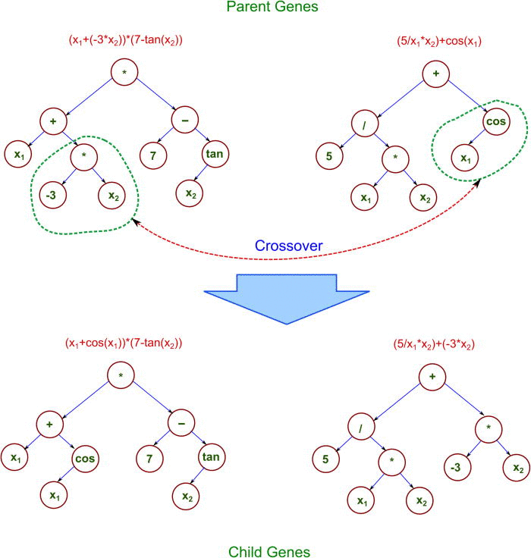
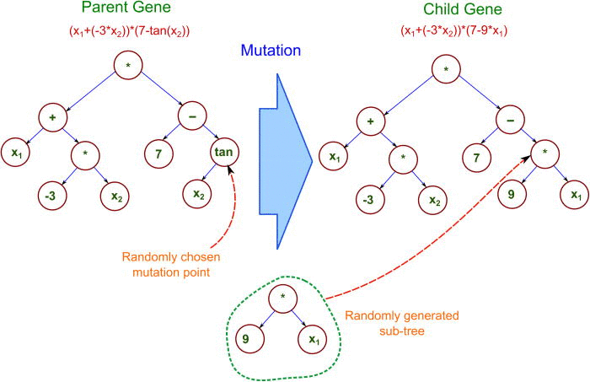
Genetic Programming (GP)
Genetic Operators (tree-based)
Crossover: randomly select a sub-tree from each parent, and swap them
Mutation: randomly select a sub-tree from the parent, and replace the sub-tree with a randomly generated sub-tree (e.g., grow)
Reproduction: copy the parent directly

Slide 30
GP to Learn CO Heuristic
Initialise a population of heuristics
Design a framework
Fitness evaluation
Determine a training set
Stop?
Return the best individual
Design a fitness function
Parent selection
Breeding offspring
The framework with the heuristic obtains/returns a solution to a given instance

Slide 31
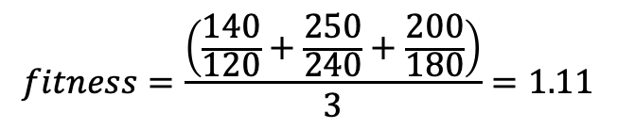
Fitness Evaluation
Heuristic
Framework
Training
Ref value
Solution
Obj
Instance 1
120
Heuristic
Framework
S1
140
Instance 2
240
Heuristic
Framework
S2
250
Instance 3
180
Heuristic
Framework
S3
200
$$fitness=\frac{\left(\frac{140}{120}+\frac{250}{240}+\frac{200}{180}\right)}{3}=1.11$$

Slide 32
Design Questions
Representation
Framework
Space Definition
Training instances
Performance measure
Surrogate models
Evaluation
Search Process
Parent selection
Genetic operators
Generality and Beyond

Slide 33
Representation
Instance
Framework
Framework
Input: Instance
Output: Solution
Parameters: Heuristic to be learned
Constructive heuristic
Improvement heuristic / operator
Parameters
Space Definition (Set of all possible heuristics)
Features / Terminals
Functions / Non-terminals
Model structure (tree-based, linear-based, …)
Possible combinations (Grammar)
Component
Component
Heuristic
Component
Parameter
Parameter
Solution

Slide 34
Framework
The framework is usually designed based on intuition and domain knowledge
Take an existing algorithm: everything is manually designed and hard coded
Identify the component(s) of the existing algorithm to be learned
Parametrise the identified component(s)
Examples
Learn flexible job shop scheduling heuristics
Learn ambulance dispatching heuristics

Slide 35
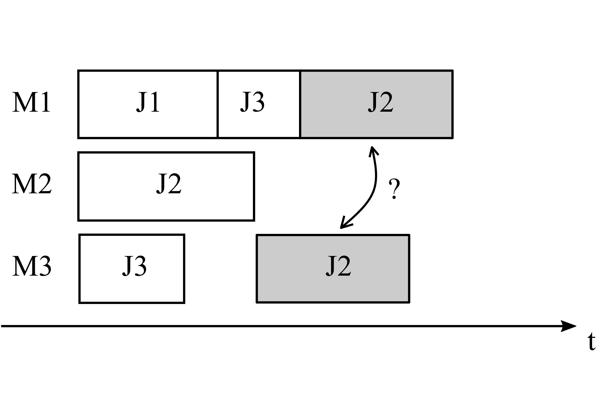
Flexible Job Shop Scheduling Heuristics
Process set of jobs by a set of machines
Each job has a sequence of operations
Each operation can be processed by multiple candidate machines
Routing decision: select a machine for an operation
Sequencing decision: select the next operation from a machine’s queue
M1
O21
O12
O31
M2
O11
M3
Sequencing
Routing

Slide 36
Framework 1: non-delay
Select machine as soon as an operation is ready
Select operation as soon as a machine becomes idle
Routing
Priority
Sequencing
Priority
Machine 1
Op 1
Idle Machine
Op 2
Ready op
Machine 2
Op 3
Op 4
Machine 3
Daniel Yska, Yi Mei, and Mengjie Zhang. Genetic programming hyper-heuristic with cooperative coevolution for dynamic flexible job shop scheduling. In Proceedings of the European Conference on Genetic Programming (EuroGP), pages 306--321. 2018

Slide 37
Framework 2: delayed-routing
Routing (machine selection) is delayed until at least one candidate machine becomes idle
M1
Score
M2
Op 1
Ready op
M2
Idle M1
Op 2
M3
Op 3
M3
Op 4
No Routing:
no machine is idle
Sequencing
(+ delayed routing)
Binzi Xu, Yi Mei, Yan Wang, Zhicheng Ji, and Mengjie Zhang. Genetic programming with delayed routing for multi-objective dynamic flexible job shop scheduling. Evolutionary Computation, 29(1):75--105, apr 2021

Slide 38



Ambulance Dispatching
Dispatch ambulances to emergency calls
Highly dynamic environment (new calls over time)
Ambulances interact and collaborate with each other

Slide 39
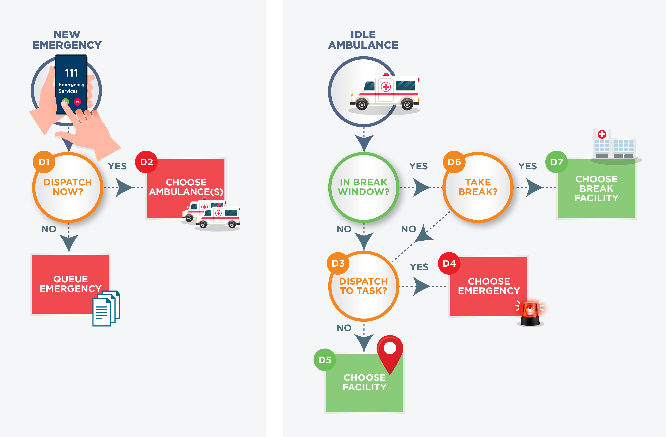
Ambulance Dispatching

Slide 40





Framework for Ambulance Dispatching
Framework 1 (non-delay)
Need 2 heuristics
Ambulance selection when emergency is waiting
Emergency selection when ambulance is idle
Framework 2 (delayed ambulance selection)
When a new emergency arrives, add it into the central waiting queue.
Need 1 heuristic
Emergency selection when ambulance is idle
Jordan MacLachlan, Yi Mei, Fangfang Zhang, Mengjie Zhang, and Jessica Signal. Learning emergency medical dispatch policies via genetic programming. In Proceedings of the ACM GECCO, pages 1409--1417. ACM, jul 2023.

Slide 41
Space Definition: Terminals
Consider all the features that might affect the decisions
But this will lead to a huge GP search space
Can alleviate by feature/terminal selection
Q: How do we know which features are important?
A: If a feature is used by many different good heuristics
But we don’t have many different good heuristics

Slide 42
Space Definition: Terminals
Collect a diverse set of good heuristics
Calculate the importance of each terminal to each heuristic
Select terminals by aggregated importance
GP run
Heuristic
Heuristic
GP run with Niching and Surrogate
Heuristic
GP run with Niching
GP run
Heuristic
Heuristic
Heuristic
GP run
Heuristic
Heuristic
Heuristic
[Intuitive]: Several independent GP runs, gather the best-of-run heuristics
[Better]: A single GP run with niching, gather the diverse local optimal heuristics
[Best]: A single GP run with niching, and surrogate evaluation
Yi Mei, Mengjie Zhang, and Su Nyugen. Feature selection in evolving job shop dispatching rules with genetic programming. In Proceedings of the Genetic and Evolutionary Computation Conference (GECCO), pages 365--372. ACM, 2016.
Yi Mei, Su Nguyen, Bing Xue, and Mengjie Zhang (2017). An efficient feature selection algorithm for evolving job shop scheduling rules with genetic programming. IEEE Transactions on Emerging Topics in Computational Intelligence, 1(5), 339-353.

Slide 43
Space Definition: Model Structure
Tree-based structure
Abstract syntax tree of program
Linear-based structure
A sequence of register-based instructions
Can represent a Directed Acyclic Graph (DAG)
Easy reuse of building blocks

Slide 44
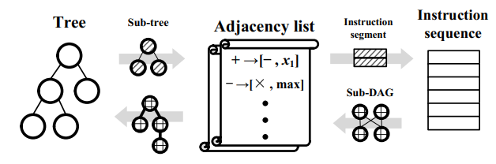
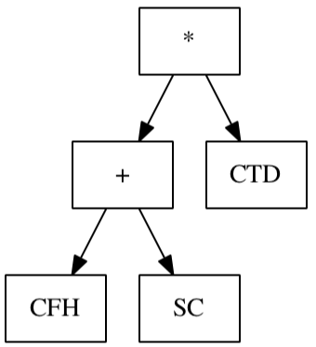
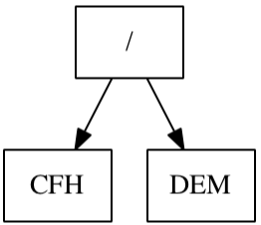
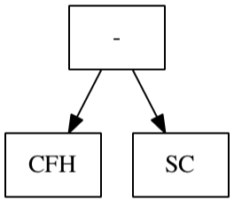
Space Definition: Model Structure
Using tree-based and linear-based representation simultaneously
Multiple sub-populations, each with a different representations
Interact with crossover
Adjacency list as intermediate
Multi-tree / Ensemble representation
Each tree stands for a different heuristic (e.g., routing and sequencing rules)
Trees collaborate to make decision (e.g., voting)
=
+
+
+ …

Slide 45
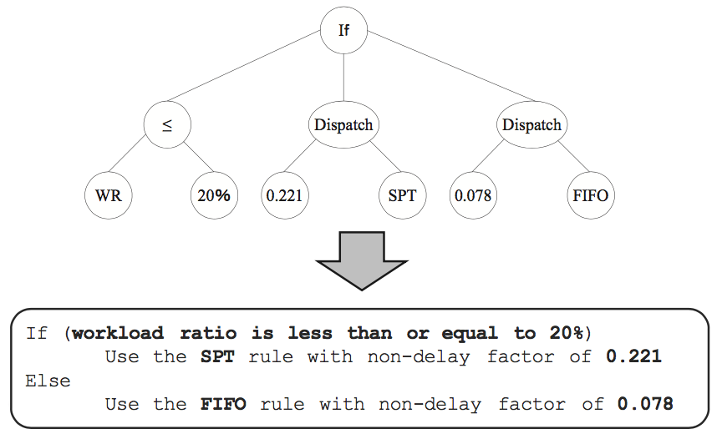
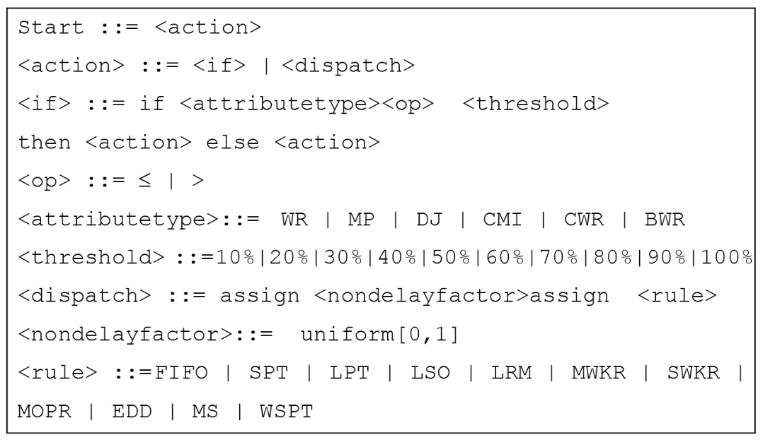
Space Definition: Grammar
Restrict how features/terminals can be combined
Smaller search space, better interpretability
Disconnected space, may lose effectiveness
Example: grammar for meaningful dispatching rules
Recursive depth-first sampling, generate a tree
Nguyen, S., Zhang, M., Johnston, M. and Tan, K.C., 2013. A computational study of representations in genetic programming to evolve dispatching rules for the job shop scheduling problem. IEEE Transactions on Evolutionary Computation, 17(5), pp.621-639.

Slide 46
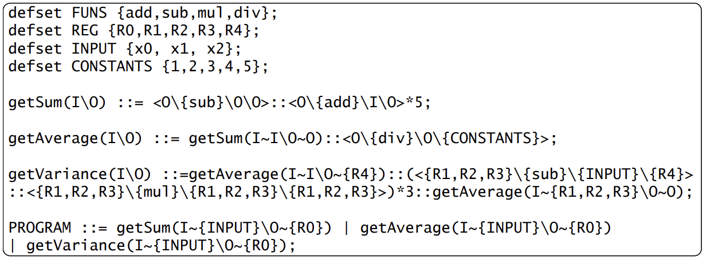
Space Definition: Grammar
Linear GP can also have grammar!
Module Context-Free Grammar for sequence of instructions
Grammar rules based on domain knowledge
Derivation tree based on grammar
LGP program based on derivation tree
Z. Huang, Y. Mei, F. Zhang, and M. Zhang, “Grammar-guided Linear Genetic Programming for Dynamic Job Shop Scheduling,” in Proceedings of the Genetic and Evolutionary Computation Conference (GECCO), Jul. 2023, pp. 1137–1145. [GP Track Best Paper Award]

Slide 47
Evaluation
Training instances
A wide range of training instances is needed for generalization
However, too many training instances will slow down the evaluation and waste resources
Generalisation vs Efficiency
Performance metrics
Effectiveness (e.g., quality of obtained solutions)
Efficiency (computational complexity)
Interpretability
…
Surrogate models

Slide 48
Training Instances
A wide range of training instances + instance rotation
Similar to batch learning
Split the training instances into small subsets (batches)
At each generation, use a different subset (same for all individuals in the population)
Training set
Instance rotation
1
4
8
5
1
9
3
7
6
2
5
2
3
8
4
9
6
7
Gen 1
Gen 2
Gen 3
……
Hildebrandt, T., Heger, J., & Scholz-Reiter, B. (2010, July). Towards improved dispatching rules for complex shop floor scenarios: a genetic programming approach. In Proceedings of the 12th annual conference on Genetic and evolutionary computation (pp. 257-264).

Slide 49
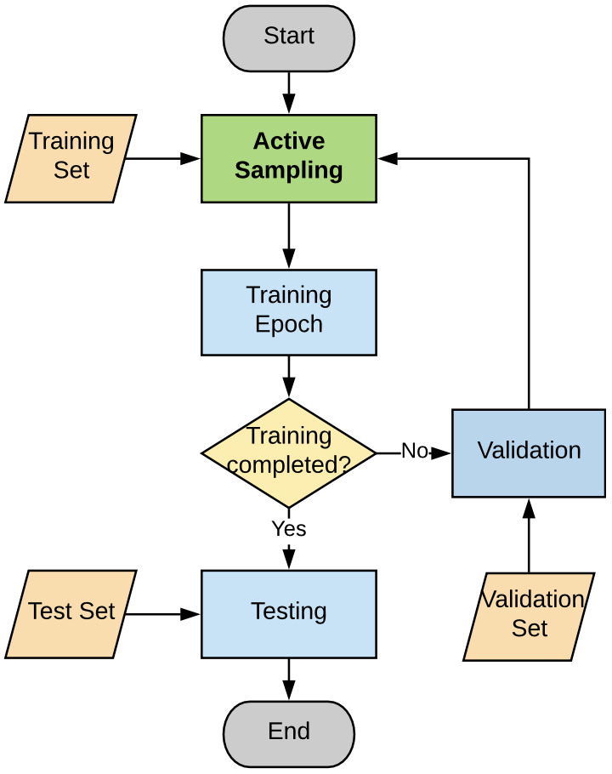
Training Instances
Intelligently select/sample the best training instances
Remove the instances that have been solved well
Add/Retain the instances that are not solved
Focus on the instances that best distinguish good/bad heuristics
Evolve Solver
Replace an existing instance solved better
Mutate training instances
Tang, K., Liu, S., Yang, P., & Yao, X. (2021). Few-shots parallel algorithm portfolio construction via co-evolution. IEEE Transactions on Evolutionary Computation, 25(3), 595-607.
Karunakaran, D., Mei, Y., Chen, G., & Zhang, M. (2019, June). Active sampling for dynamic job shop scheduling using genetic programming. In 2019 IEEE Congress on Evolutionary Computation (CEC) (pp. 434-441). IEEE.

Slide 50
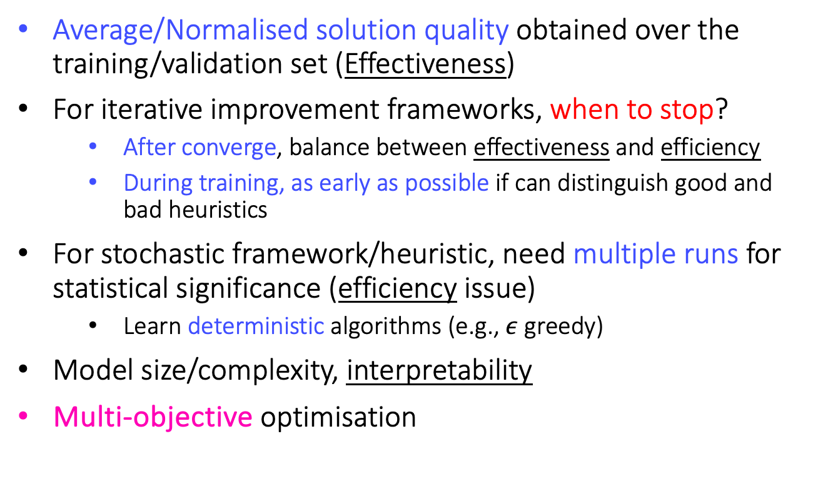
Performance Metrics
Average/Normalised solution quality obtained over the training/validation set (Effectiveness)
For iterative improvement frameworks, when to stop?
After converge, balance between effectiveness and efficiency
During training, as early as possible if can distinguish good and bad heuristics
For stochastic framework/heuristic, need multiple runs for statistical significance (efficiency issue)
Learn deterministic algorithms (e.g., $ε$ greedy)
Model size/complexity, interpretability
Multi-objective optimisation

Slide 51
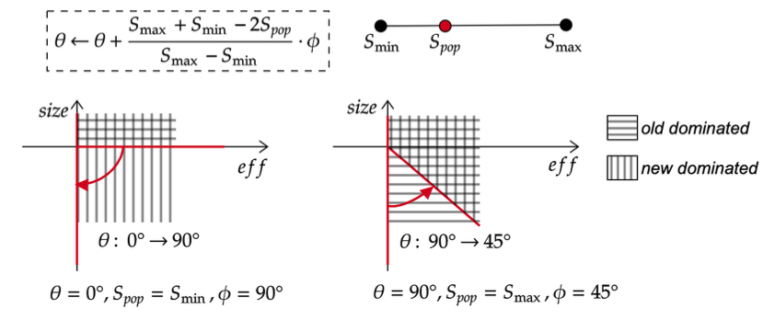
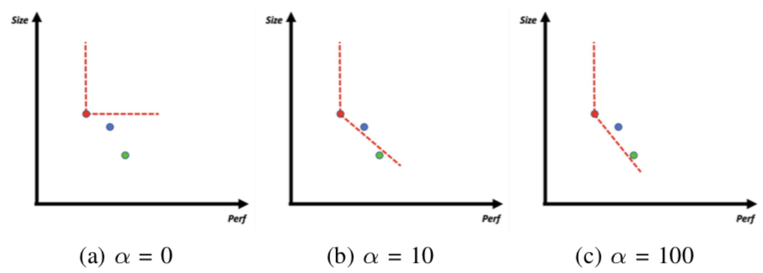
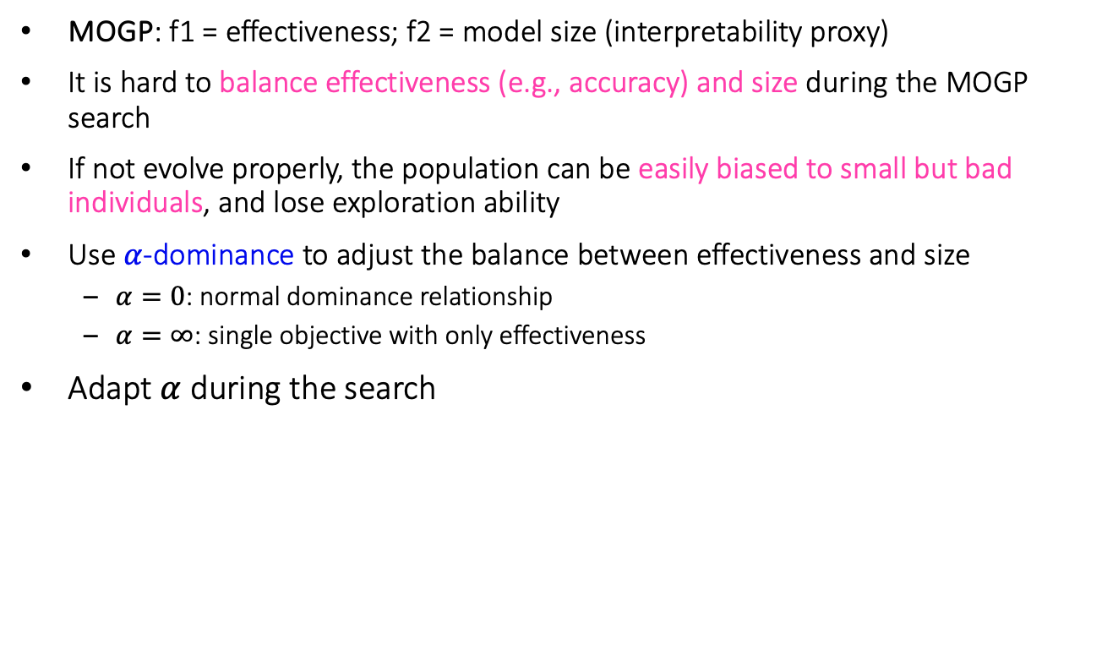
Effectiveness vs Interpretability
MOGP: f1 = effectiveness; f2 = model size (interpretability proxy)
It is hard to balance effectiveness (e.g., accuracy) and size during the MOGP search
If not evolve properly, the population can be easily biased to small but bad individuals, and lose exploration ability
Use $α$-dominance to adjust the balance between effectiveness and size
$α=0$: normal dominance relationship
$α=∞$: single objective with only effectiveness
Adapt $α$ during the search
Shaolin Wang, Yi Mei, and Mengjie Zhang. A multi-objective genetic programming algorithm with αdominance and archive for uncertain capacitated arc routing problem. IEEE Transactions on Evolutionary Computation, jul 2022

Slide 52
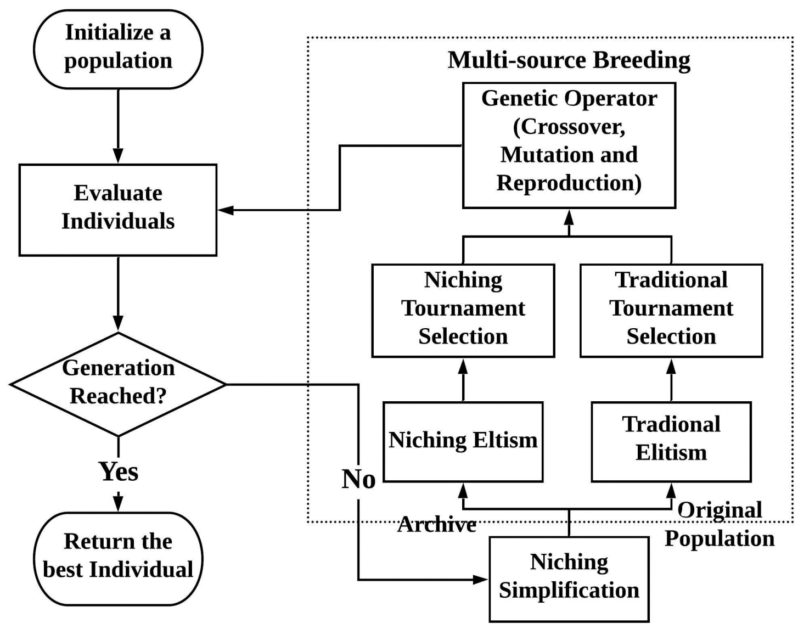
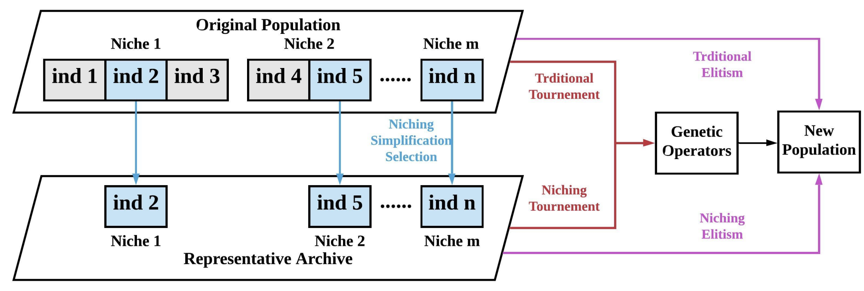
Effectiveness vs Interpretability
Niching GP
Group individuals into niches, each niche contains individuals with the same fitness value
Niching selection: select the smallest individual from each niche
Multi-source breeding
Shaolin Wang, Yi Mei, Mengjie Zhang, and Xin Yao. Genetic programming with niching for uncertain capacitated arc routing problem. IEEE Transactions on Evolutionary Computation, 26(1):73--87, feb 2022

Slide 53
Surrogate Models
Brood recombination: generate a large number of offspring
Surrogate pre-selection: use surrogate to predict fitness and select the best parts
Brood recombination + surrogate pre-selection
Current population
Crossover/mutation
Best surrogate fitness
Evaluate using surrogate
Full evaluation
Surrogate model

Slide 54
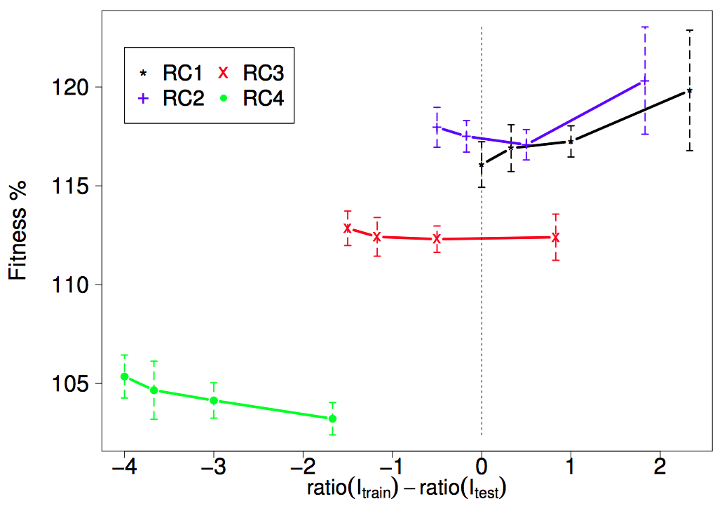
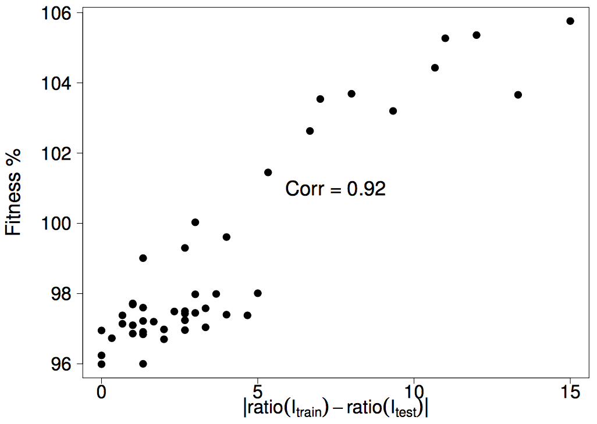
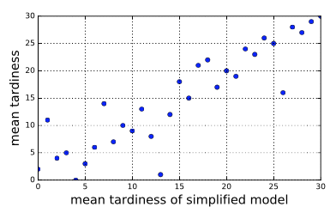
Surrogate Models
Small instances with careful configurations, faster and correlated
Static JSS
Dynamic JSS
Configuration | Original | Surrogate
No. Machines | 10 | 5
No. Jobs | 5000 | 500
No. Warmup Jobs | 500 | 100
Min Ops | 2 | 2
Max Ops | 14 | 7
Yi Mei, Mengjie Zhang, "A Comprehensive Analysis on Reusability of GP-Evolved Job Shop Dispatching Rules," IEEE World Congress in Computational Intelligence (WCCI), Vancouver, Canada, 2016.
Nguyen, S., Zhang, M. and Tan, K.C., Surrogate-Assisted Genetic Programming With Simplified Models for Automated Design of Dispatching Rules. IEEE Transactions on Cybernetics, DOI 10.1109/TCYB.2016.2562674.

Slide 55
Surrogate Models
Semantic/Phenotypic Characterisation
Convert a tree structure to a numeric vector
Characterisation
Numeric semantic vector
Surrogate model
Predicted fitness
GP tree
Hildebrandt, T. and Branke, J., 2015. On using surrogates with genetic programming. Evolutionary computation, 23(3), pp.343-367.

Slide 56
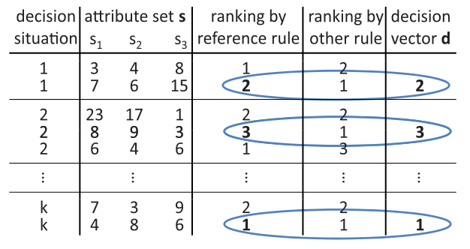
Surrogate Models
An example in learning dispatching rules for dynamic job shop scheduling
A set of decision situations and a reference rule
For each decision situation, measure the difference between the reference rule and the characterised rule
Characterised by a decision vector
2
3
…
1
Hildebrandt, T. and Branke, J., 2015. On using surrogates with genetic programming. Evolutionary computation, 23(3), pp.343-367.

Slide 57
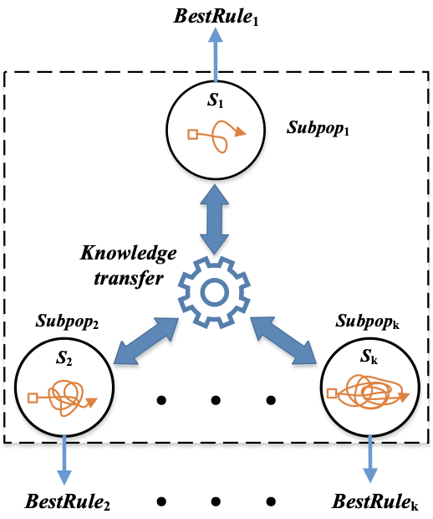
Surrogate Models
One can have multi-fidelity surrogate models
Different problem size, model complexity, …
Accuracy vs Speed
Use multiple sub-populations
Each uses a different surrogate (different fidelities)
Sub-populations transfer knowledge by sharing parents to generate offspring
One sub-population uses the original model (highest fidelity) and returns the final individual
Fangfang Zhang, Yi Mei, Su Nguyen, and Mengjie Zhang. "Collaborative Multi-fidelity Based Surrogate Models for Genetic Programming in Dynamic Flexible Job Shop Scheduling". IEEE Transactions on Cybernetics, Doi: 10.1109/TCYB.2021.3050141.

Slide 58
Search Process
Parent Selection
Commonly used: tournament selection
Lexicase selection for better diversity
Genetic Operators

Slide 59
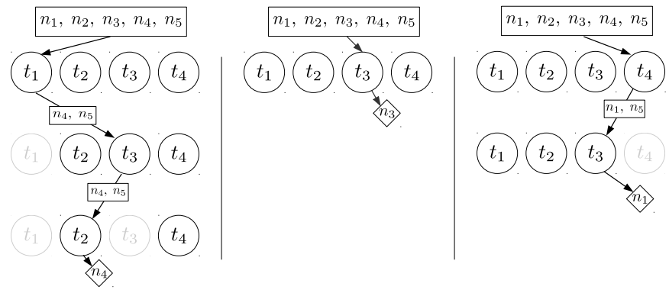
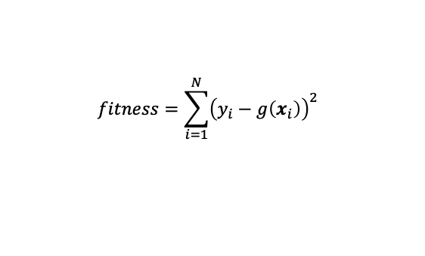
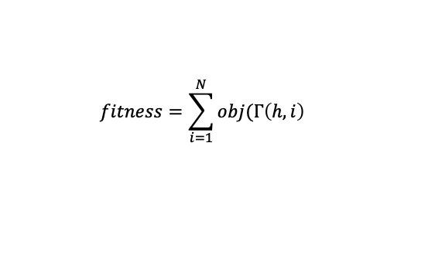
Lexicase Selection
Find specialists instead of generalists
Multiple cases that compose the fitness function
Randomly iterate through cases
For each case, only keep the individuals with the best case-fitness
Stop if only one individual retains
Case definition
Instances:
$$fitness=\sum_{i=1}^{N}{{\left(y_{i}−g\left(x_{i}\right)\right)}^{2}}$$
Case-fitness
$$fitness=\sum_{i=1}^{N}{obj(Γ\left(h, i\right)}$$
Case-fitness
Helmuth, T., Spector, L., & Matheson, J. (2014). Solving uncompromising problems with lexicase selection. IEEE Transactions on Evolutionary Computation, 19(5), 630-643. Xu, M., Mei, Y., Zhang, F., & Zhang, M. (2023). Genetic programming with lexicase selection for large-scale dynamic flexible job shop scheduling. IEEE Transactions on Evolutionary Computation.

Slide 60
Genetic Operators
Completely random
Adaptive during the search process
Adjust the probability distribution of sampling nodes in mutation
In crossover, replace less important sub-trees with more-important sub-trees

Slide 61


Adaptive Mutation
Adjust probability of terminals based on historical occurrences
A terminal is sampled with a higher probability if it occurs more often in individuals with better fitness
After each generation,
$$w_{i}\left(t\right)=w_{i}\left(t−1\right)+\sum_{j=1}^{P}{\frac{count\left(i,j\right)×fitness_{j}}{\sum_{k=1}^{n}{count(i,j)}}}$$
Riley, M., Mei, Y., & Zhang, M. (2016, July). Improving job shop dispatching rules via terminal weighting and adaptive mutation in genetic programming. In 2016 IEEE Congress on Evolutionary Computation (CEC) (pp. 3362-3369). IEEE.

Slide 62




Adaptive Crossover
Contribution of a sub-tree to the individual based on behaviour consistency (correlation)
Less contribution will be more likely to be replaced
Zhang, F., Mei, Y., Nguyen, S., & Zhang, M. (2021). Correlation coefficient-based recombinative guidance for genetic programming hyperheuristics in dynamic flexible job shop scheduling. IEEE Transactions on Evolutionary Computation, 25(3), 552-566.

Slide 63



Generality and Beyond
Hardly possible to have a generalist heuristic for ALL possible scenarios
Too much to learn specialist heuristic for each scenario
Multitask Learning (parallel)
Learn heuristics for multiple scenarios simultaneously
Transfer Learning (sequential)
Reuse knowledge to improve learning performance for new scenarios
Heuristic
1
Heuristic
2
Heuristic
3

Slide 64


Multitask GP
Multiple subpopulations, each for a task
subpopulations interact by crossover, retaining only one offspring more similar to the origin task
Zhang, F., Mei, Y., Nguyen, S., Tan, K. C., & Zhang, M. (2021). Multitask genetic programming-based generative hyperheuristics: A case study in dynamic scheduling. IEEE Transactions on Cybernetics, 52(10), 10515-10528.

Slide 65

Multitask GP
Migrate offspring among sub-populations based on their effectiveness, evaluated by surrogate
Zhang, F., Mei, Y., Nguyen, S., Zhang, M., & Tan, K. C. (2021). Surrogate-assisted evolutionary multitask genetic programming for dynamic flexible job shop scheduling. IEEE Transactions on Evolutionary Computation, 25(4), 651-665.

Slide 66


GP with Knowledge Transfer
What to transfer? Final (sub-)trees, feature importance, …
When to transfer? Initialisation, breeding, …
How to transfer? Directly transfer, adjust probabilities, …
Direct (sub)-tree
High-level: feature importance
Yi Mei, Mazhar Ansari Ardeh, and Mengjie Zhang. Knowledge transfer in genetic programming hyper-heuristics. In Automated Design of Machine Learning and Search Algorithms, pages 149--169. Springer, 2021

Slide 67

GP with Knowledge Transfer
GP with Knowledge-Guided Search
Guided initialization: select the best inidividuals from the source domain
Guided crossover/mutation: to avoid individuals that have been seen in the source domain, to reduce negative transfer
Ardeh, M. A., Mei, Y., & Zhang, M. (2021). Genetic programming with knowledge transfer and guided search for uncertain capacitated arc routing problem. IEEE Transactions on Evolutionary Computation, 26(4), 765-779.

Slide 68
Machine Learning to Aid Meta-heuristics (including Evolutionary Methods)

Slide 69
ML to Aid Meta-heuristics
Learn the design decisions in meta-heuristics
Algorithm selection: how to select the best algorithm for solving a given problem?
Algorithm composition: how to select the best components of the algorithm, such as initialization method, local search operators, genetic operators?
Algorithm configuration: how to automatically find the best parameter values?
Offline vs Online
Supervised vs Reinforcement Learning

Slide 70

Supervised Offline Algorithm Selection
Collect instances and characterise them
Collect algorithms
Run algorithms to instances
Learn model from instance features to selected algorithms, or predicted algorithm performance
Smith-Miles, K., Baatar, D., Wreford, B., & Lewis, R. (2014). Towards objective measures of algorithm performance across instance space. Computers & Operations Research, 45, 12-24.

Slide 71

Supervised Offline Algorithm Composition
Learning operator sequence through LSTM
Collect operator sequences
Learn LSTM for next operator prediction
Meng, W., & Qu, R. (2024). Automated design of local search algorithms: Predicting algorithmic components with LSTM. Expert Systems with Applications, 237, 121431.

Slide 72

Reinforcement Algorithm Composition
Offline + Online Adaptive Operator Selection
Train state-based policy (when to select which operator) offline from training data
Update policy online through both state-based and stateless policy for new problem instance
Jiyuan Pei, Jialin Liu, and Yi Mei. Learning from offline and online experiences: A hybrid adaptive operator selection framework. In Proceedings of the ACM Genetic and Evolutionary Computation Conference (GECCO). ACM, jul 2024

Slide 73


Reinforcement Algorithm Configuration
Irace: iterative racing for automatic parameter tuning
Repeat:
sampling new configurations according to a particular distribution,
selecting the best configurations from the newly sampled ones by means of racing,
updating the sampling distribution in order to bias the sampling towards the best configurations.
López-Ibáñez, M., Dubois-Lacoste, J., Cáceres, L. P., Birattari, M., & Stützle, T. (2016). The irace package: Iterated racing for automatic algorithm configuration. Operations Research Perspectives, 3, 43-58.

Slide 74

Encoding of Problems + States, ML Models
Encoding often highly problem-specific
Recurrent neural networks, e.g., LSTMs
Pointer networks (Vinyals et al., 2015)
Variants of Graph Neural Networks, e.g.,
Structure-to-Vector Network (Dai et al., 2016)
Graph Convolutional Network (Kipf and Welling, 2017)
Graph Isomorphism Network (Xu et al., 2019)
Graph Attention Network (Kool et al., 2019; Joshi et al., 2021)

Slide 75

Learning to Solve Graph Problems
H. Dai, E.B. Khalil, Y. Zhang, B. Dilkina, and L. Song (2017): Learning combinatorial optimization algorithmsover graphs. NeurIPS
For min vertex cover, max cut, TSP considered
structure2vec used to “featurize” nodes
variant of Q-learning used to obtain a policy for greedily constructing solutions

Slide 76


Learning to Solve Graph Problems (cont.)
A. Mittal, A. Dhawan, S. Manchanda, S. Medya, S. Ranu, A. Singh (2020): Learning Heuristics over Large Graphs via Deep Reinforcement Learning. NeurIPS.
focus on scalability to graphs with millions of nodes, for max influence, max vertex cover, max coverage problems
GCN trained in supervised fashion to predict likelihood of each node to be part of a solution
Q-learning finds combination of most promising nodes $Q(S, v)$: long-term reward for adding node v to solution $S$ approximated by a comparatively simple neural net

Slide 77


Learning to Solve Graph Problems (cont.)
W. Kool, H. van Hoof, M. Welling (2019): Attention, learn to solve routing problems!, ICLR
Autoregressive attention-based encoder + decoder GNN
for TSP, VRP; trained with REINFORCE

Slide 78

Learning to Solve Graph Problems (cont.)
Z. Li, Q. Chen, V. Koltun (2018): Combinatorial optimization with graph convolutional networks and guided tree search, NeurIPS
for max independent set, min vertex cover, max clique, SAT
GCN used to predict likelihood of each node to be part of a solution; yields multiple probability
heuristic tree search utilizing multiple maps, graph reduction, local search applied
supervised learning

Slide 79

Basic Idea of AlphaZero
D. Silver et al. (2018). A general reinforcement learning algorithm thatmasters chess, shogi, and Go through self-play. Science, 362(6419)
Learns only by iterated selfplay
Monte Carlo Tree Search (MCTS) applied to obtain a policy and select a move
States are evaluated by a Deep NN Quality of NN output is amplified by MCTS!

Slide 80
Learning to Solve Graph Problems (cont.)
K. Abe, Z. Xu, I. Sato, M. Sugiyama, M. (2020): Solving NP-hard problems on graphs with extended AlphaGo zero.arXiv:1905.11623
for min vertex cover, max cut, max clique problems
based on AlphaGoZero
different GNNs tested
special reward normalization applied
J. Huang, M. Patwary, and G. Diamos (2019): Coloring big graphs with AlphaGoZero. arXiv:1902.10162
similar approach for coloring huge graphs
special FastColorNet neural network architecture

Slide 81

Learning Beam Search (LBS)
M. Huber and G. Raidl (2021). Learning beam search: Utilizing machine learning to guide beam search for solving combinatorial optimization problems. Machine Learning, Optimization, and Data Science (LOD 2021)

Slide 82

LBS for the Longest Common Subsequence Problem

Slide 83

LBS Experiments: Approximation of Real LCS Length
The learned network of LBS approximates the real expected LCS lengths better than EX:

Slide 84
LBS Experiments: Results
Results on rat and BB LCS benchmark instances:
NN: MLP with 20+20 hidden nodes
Features: remaining input string lengths, remaining min. letter occurrences
Beam width:
LBS training done with β = 50
Low computation time tests with β = 50 on 13 out of 28 instances new best results
High quality tests with β = 600 on +7 out of 28 instances new best results
Also successfully considered:Constrained LCS, shortest common supersequence problem, no-wait flow shop problem

Slide 85

Learning in Large Neighborhood Search
Main principle of Large Neighborhood Search:
Iteratively apply destroy and repair operators
Destroy: e.g., remove orders from a VRP tour, remove values assigned to variables
Repair: e.g., fast greedy heuristics, dynamic progarmming, solve a mixed integer linear program
One of the most prominent metaheuristics, e.g., in transport optimization
D. Pisinger, S. Ropke (2010): Large Neighborhood Search, Handbook of Metaheuristics, 2nd edition, 399-420, Springer

Slide 86

Learning in Large Neighborhood Search
Selection of destroy/repair operators, e.g.,
J. Kallestad, R. Hasibi, A. Hemmati, K. Sörensen (2023): A General Deep Reinforcement Learning Hyperheuristic Framework for Solving Combinatorial Optimization Problems, EJOR
S.-N. Johnn, V.-A. Darvariu, J. Handl, J. Kalcsics (2023): Graph Reinforcement Learning for Operator Selection in the ALNS Metaheuristic, OLA.
Selection of what to destroy, e.g.,
J. Song, R. Lanka, Y. Yue, B. Dilkina (2020): A General Large Neighborhood Search Framework for Solving Integer Linear Programs, NeurIPS
R. Addanki, V. Nair, M. Alizadeh (2020): Neural Large Neighborhood Search, NeurIPS
N. Sonnerat, P. Wang, I. Ktena, S. Bartunov, V. Nair (2021): Learning a Large Neighborhood Search Algorithm for Mixed Integer Programs, arXiv:2107.10201
Y. Wu, W. Song, Z. Cao, J. Zhang (2021): Learning Large Neighborhood Search Policy for Integer Programming, NeurIPS
T. Huang, A. Ferber, Y. Tian, B. Dilkina, B. Steiner (2023): Searching Large Neighborhoods for Integer Linear Programs with Constrastive Learning, ICML

Slide 87

Example: Learning a Destroy Policy In LNS
F. Oberweger, G. Raidl, E. Rönnberg, and M. Huber (2022): A Learning Large Neighborhood Search for the Staff Rerostering Problem, CPAIOR, Springer LNCS 13292
Given: old schedule, disruptions, demand to be met
Goal: create new schedule
meeting new demand as best as possible (soft)
having as few changes to old schedule as possible (soft)
meeting all hard constraints, e.g., work regulations

Slide 88

Example: Learning a Destroy Policy In LNS
Initial solution from greedy heuristic
Destroy guided by a graph neural network
Repair by solving a MILP

Slide 89

Example: Learning a Destroy Policy In LNS
Model current solution as a graph in each state of LNS
Use Graph Neural Network (GNN) from Scarselli et al. (2008)
Predict probability of each employee-day pair to belong to destroy set yielding highest improvement
Select with randomized sampling procedure enforcing selection of segments

Slide 90
Example: Learning a Destroy Policy In LNS
Training
Offline with representative problem instances via imitation learning
Expert policy: MILP with local branching constraint to determine optimal destroy set (very slow)
Loss function: log-likelihood of expert actions, cross-entropy for temperature
DAGGER (Ross et al., 2011): Trajectories are first created with expert strategy, later with learned model

Slide 91



Example: Learning a Destroy Policy In LNS
Some results
Model trained with $|N |=110$employees; MILP solver: Gurobi
Pure MILP optimality gap between 26% and 34%
Comparison of LNS RND and LNS NN optimality gaps. 15 minutes running time. Lower bounds from solving MILP for three hours.

Slide 92
Challenges and Future Directions

Slide 93
Challenges and Future Directions
Highly active research area, learning promising to improve on classical optimization in combinatorial optimization, BUT:
End-to-end ML approaches are usually not (yet) competitive to carefully crafted classical approaches for COPs
Most often, combinations appear most promising
Generalization to larger instances or instances of other types often is hard
Obtaining training data and training often very time-consuming
Deep reinforcement learning does not need labeled data, but often is tricky in practice
Understand/Interpret the learned algorithms

